Slide 1
System Calls
Yubin Xia
IPADS, SJTU
ACKs: Some slides are adapted from the textbook’s original slides and Frans’s os course notes

Slide 2
Review: OS as Services
Exception/syscalls
Application (CPU)
Exception
Table
OS
Services
I/O Device
Interrupt
Notes:
Question: what if

Slide 3
Review: Maximizing Parallelism
Keep all I/O devices as busy as possible
In general, an I/O interrupt represents the end of an operation
Another request should be issued ASAP
Most devices do not interfere with each others' data structures
No reason to block out other devices

Slide 4
Review: Top and Bottom Halves
Top-half: do minimum work and return
ISR (Interrupt Service Routine)
Bottom-half: deferred processing
softirqs, tasklets, workqueues, kernel threads
Top half
Bottom half
tasklet
softirq
workqueue
kernel thread

Slide 5
System Calls

Slide 6
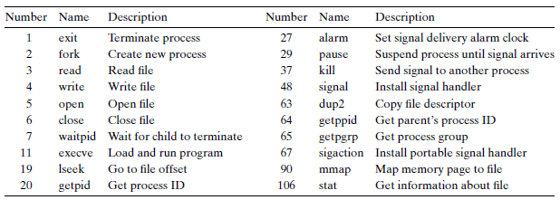
System Calls in Previous Classes (Partial)

Slide 7
Review: Open Files
Why return fd?
Why not pointer?
#include <sys/types.h>
#include <sys/stat.h>
#include <fcntl.h>
int open(char *filename, int flags, mode_t mode);
Returns: new file descriptor if OK, -1 on error
flags
O_RDONLY, O_WRONLY, O_RDWR (must have one)
O_CREAT, O_TRUNC, O_APPEND (optional)
mode
S_IRUSR, S_IWUSR, S_IXUSR
S_IRGRP, S_IWGRP, S_IXGRP
S_IROTH, S_IWOTH, S_IXOTH

Slide 8
FD Table & Opened File Table after fork()
open file table
(shared by all processes)
V-node table
(shared by all processes)
file A
file A
Descriptor table (one table per process)
file pos
File access
refcnt = 1
File size
fd0
...
File type
fd1
file B
…
fd2
file B
fd3
File access
fd4
file pos
fd5
refcnt = 1
File size
fd6
...
File type
fd7
…

Slide 9
Redirection by dup2(4,1) after fork()
open file table
(shared by all processes)
V-node table
(shared by all processes)
file A
file A
Descriptor table (one table per process)
file pos
File access
refcnt = 0
File size
fd0
...
File type
fd1
file B
…
fd2
file B
fd3
File access
fd4
file pos
fd5
refcnt = 2
File size
fd6
...
File type
fd7
…

Slide 10
Tracing System Calls
Linux has a powerful mechanism for tracing system call execution for a compiled application
Output is printed for each system call as it is executed, including parameters and return codes
The ptrace() system call is used
Also used by debuggers (breakpoint, singlestep, etc)
Use the "strace" command (man strace for info)
You can trace library calls using the "ltrace" command

Slide 11
Using strace
int main() {
write(1, "Hello world!\n", 13);
}
$ strace -o hello.out ./hello
execve("./hello2", ["./hello2"], [/* 59 vars */]) = 0
uname({sys="Linux", node="kiwi", ...}) = 0
brk(0) = 0xca9000
brk(0xcaa1c0) = 0xcaa1c0
arch_prctl(ARCH_SET_FS, 0xca9880) = 0
brk(0xccb1c0) = 0xccb1c0
brk(0xccc000) = 0xccc000
write(1, "Hello world!\n", 13) = 13
exit_group(13) = ?
Notes:
arch_prctl: set architecture-specific thread state. ARCH_SET_FS Set the 64-bit base for the FS register to addr.

Slide 12
Make a System calL

Slide 13
2 Ways to Do System Calls: From Coder’s View
Using C (glibc)
E.g., open()
Application
1
Using assembly
E.g., "int 0x80"
Library
2
Kernel

Slide 14
3 Ways to Do System Calls: From Machine’s View
int 0x80
SYSENTER
SYSCALL
Application
Library
Kernel

Slide 15
Example of Calling exit()
int main(int argc, char *argv[]) {
unsigned int syscall_nr = 60; // 60 is for exit()
int exit_status = 42; // 42 is the return value
asm ("movl %0, %%eax\n"
"movl %1, %%ebx\n"
"int $0x80"
:
: "m" (syscall_nr), "m" (exit_status)
: "eax", "ebx");
}

Slide 16
Lib-call / Syscall Return Codes
Library calls return -1 on error and place a specific error code in the global variable errno
System calls return specific negative values to indicate an error in %eax
Most system calls return -errno
The library wrapper code is responsible for conforming the return values to the errno convention

Slide 17
Passing System Call Parameters
The first parameter is always the syscall #
eax on Intel
Linux allows up to six additional parameters
ebx, ecx, edx, esi, edi, ebp on Intel
System calls that require more parameters package the remaining params in a struct and pass a pointer to that struct as the sixth parameter
Problem: must validate pointers
Could be invalid, e.g. NULL ➔ crash OS
Or worse, could point to OS, device memory ➔ security hole

Slide 18
How to validate user pointers?
Too expensive to do a thorough check
Need to check that the pointer is within all valid memory regions of the calling process
Solution: No comprehensive check
Linux does a simple check for address pointers and only determines if pointer variables are within the largest possible range of user memory (more details when talking about process)
Even if a pointer value passes this check, it is still quite possible that the specific value is invalid
Dereferencing an invalid pointer in kernel code would normally be interpreted as a kernel bug and generate an Oops message on the console and kill the offending process
Linux does something very sophisticated to avoid this situation

Slide 19
Handling faults due to user-pointers
Kernel code must access user-pointers using a small set of "paranoid" routines (e.g. copy_from_user())
Thus, kernel knows what addresses in its code can throw invalid memory access exceptions (page fault)
When a page fault occurs, the kernel’s page fault handler checks the faulting EIP (recall: saved by hw)
If EIP matches one of the paranoid routines, kernel will not oops; instead, will call "fixup" code
Many violations of this rule in Linux. Tons of security holes are found

Slide 20
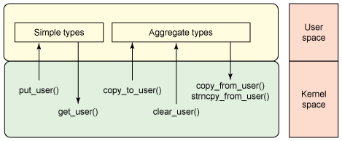
Access User’s Memory

Slide 21
Paranoid functions to access user pointers
Function | Action
get_user(), __get_user() | reads integer (1,2,4 bytes)
put_user(), __put_user() | writes integer (1,2,4 bytes)
copy_from_user(), __copy_from_user | copy a block from user space
copy_to_user(), __copy_to_user() | copy a block to user space
strncpy_from_user(), __strncpy_from_user() | copies null-terminated string from user space
strnlen_user(), __strnlen_user() | returns length of null-terminated string in user space
clear_user(), __clear_user() | fills memory area with zeros

Slide 22
New Instruction: SYSENTER/SYSEXIT & SYSCALL/SYSRET
"int 0x80" is Obsolete
Windows XP does not use it any more
That’s why it requires at least Pentium II
New Instructions
SYSENTER/SYSEXIT: Intel, and then AMD
SYSCALL/SYSRET: AMD, and then Intel

Slide 23
Simplify System Call by SYSCALL/SYSRET
SYSCALL/SYSRET has lower latency
Less than 25% of the cycles of previous solution
Why faster?
Assume OS implements a flat-memory model
Simplifies calls to and returns from the OS
Eliminating unneeded checks, and by loading pre-determined values into the CS and SS segment registers
More details: http://wiki.osdev.org/SYSENTER

Slide 24
Compatibility across Intel and AMD
For a 32-bit Kernel
SYSENTER/SYSEXIT are the only compatible pair
For a 64-bit Kernel
SYSCALL/SYSRET are the only compatible pair
In Long mode only (not Long Compat mode)

Slide 25
Using SYSCALL to Invoke the exit() System Call
#include <unistd.h>
int main(int argc, char *argv[]) {
unsigned long syscall_nr = 60;
long exit_status = 42;
syscall(syscall_nr, exit_status);
}
int main(int argc, char *argv[]) {
unsigned long syscall_nr = 60;
long exit_nr = 42;
asm ("movq %0, %%rax\n"
"movq %1, %%rdi\n"
"syscall"
: :
"m" (syscall_nr), "m" (exit_nr) :
"rax", "rdi"); }

Slide 26
System Call
Fetch the n’th descriptor from the IDT, where n is the argument of int.
Check that CPL in %cs is <= DPL, where DPL is the privilege level in the descriptor.
Save %esp and %ss in a CPU-internal registers, but only if the target segment selector’s PL < CPL.
Load %ss and %esp from a task segment descriptor.
Push %ss, %esp, %eflags, %cs, %eip,
Clear some bits of %eflags
Set %cs and %eip to the values in the descriptor

Slide 27
What does CPU do for “INT 0x80”
decide the vector number, in this case it's the 0x80 in “int 0x80’’
fetch the interrupt descriptor for vector 0x80 from the IDT.
CPU finds it by taking the 0x40'th 8-byte entry starting at the address that the IDTR CPU register points to
check that CPL <= DPL in the descriptor (but only if INT instruction).
save ESP and SS in a CPU-internal register (but only if target segment selector's PL < CPL) (*)
load SS and ESP from TSS
push user SS (*)
push user ESP (*)
push EFLAGS
push CS
push EIP
clear some EFLAGS bits (on interrupts, see below)
set CS and EIP from IDT descriptor's segment selector and offset
4, 6 and 7 are not needed if trap happens in kernel space

Slide 28
vDSO
Virtual Dynamic Shared Object

Slide 29
The Motivation of vDSO
The latency of syscall is not negligible
Especially for those called frequently
E.g., gettimeofday()
How to reduce the latency of syscall?
Most of the time is for state saving/restoring
If no mode switching, then no state saving/restoring

Slide 30
The Code of gettimeofday()
Defined by the kernel
As a part of kernel code during compiling
Run in user space
The code is loaded into a page shared with user
The page is as known as vDSO
Virtual Dynamic Shared Object
Time value is also mapped to user space (read-only)
Can only be changed in kernel mode
The source can be found in arch/x86/vdso/vclock_gettime.c

Slide 31
Where is the Shared Page for vDSO?
$ ldd `which bash`
linux-vdso.so.1 => (0x00007fff667ff000)
libtinfo.so.5 => /lib/x86_64-linux-gnu/libtinfo.so.5 (0x00007f623df7d000)
libdl.so.2 => /lib/x86_64-linux-gnu/libdl.so.2 (0x00007f623dd79000)
libc.so.6 => /lib/x86_64-linux-gnu/libc.so.6 (0x00007f623d9ba000)
/lib64/ld-linux-x86-64.so.2 (0x00007f623e1ae000)

Slide 32
Flex-SC
Flexible System Call Scheduling with Exception-Less System Calls, OSDI’10

Slide 33
The Motivation
How to further reduce the latency of syscall?
Not only for gettimeofday()
Where does the latency come from?
Mostly for the state switch
Save and restore states
Privilege checking
Cache pollution
Could we do syscall without state switching?

Slide 34
Flexible System Call
New syscall mechanism – Flexible System Call
Introduce system call page that is shared by user & kernel
User threads can push the system call requests into the system call page
kernel threads will poll the system call requests out the system call page
Exception-less syscall
Remove synchronicity by decoupling invocation from execution

Slide 35
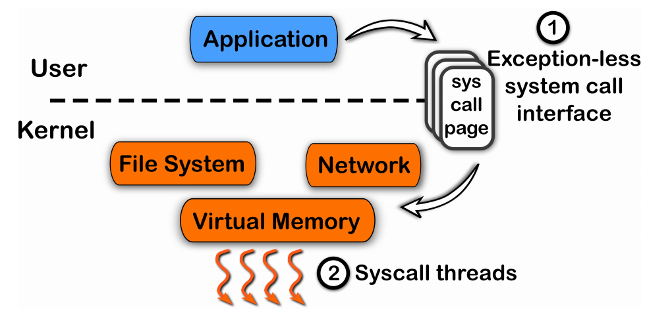
Another Way for System Call

Slide 36
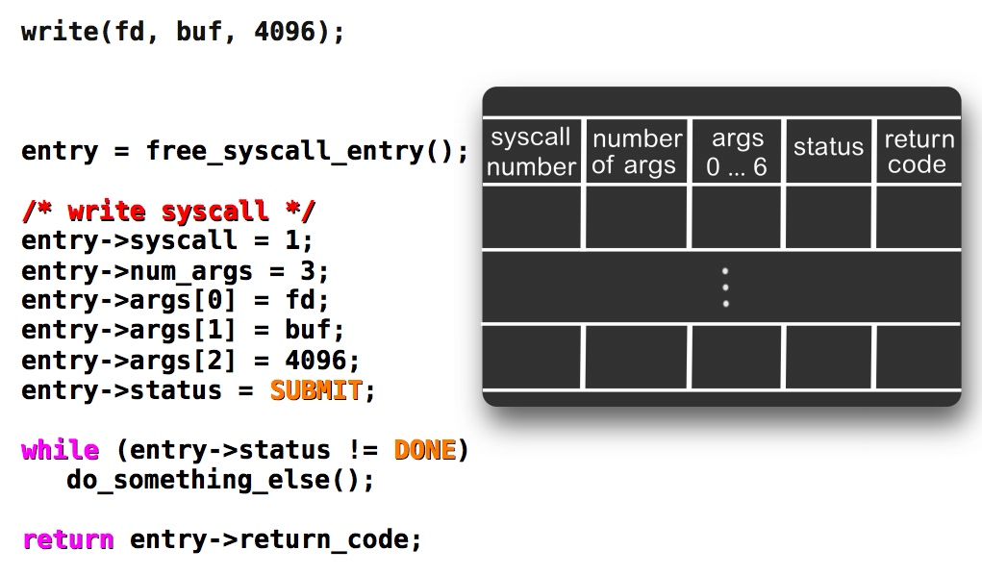
Exception-less System Call

Slide 37
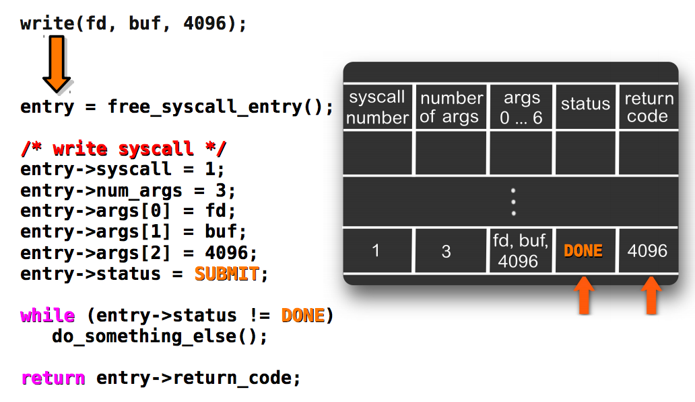
Kernel Fill the Results

Slide 38
On a Single Core: Single Threads
Application
Push system call
User
Kernel
Sys call page
Sys call page
Switch to user
Sys call page
Switch to kernel
a
b
c
d
Kernel threads
pull system call

Slide 39
On a Single Core: Multiple Threads
switch
switch
switch
user thread
user thread
user thread
user thread
user thread
user thread
user thread
user thread
Push system call
Sys call page
Push system call
Sys call page
Push system call
Push system call
Sys call page
a
b
User mode
Kernel mode
Switch to kernel
Switch to user
c
d
kernel thread
pull system call
FlexSC: Flexible System Call Scheduling with Exception-Less System Calls

Slide 40
Summary

Slide 41
Summary
System call VS. function call
Trap! Switching the mode
State saving/restoring, changing stack, checking…
‘Int 0x80’ is not enough
New instructions for lower latency
vDSO for reducing trapping
FlexSC for further reducing trapping by multi-core

Slide 42
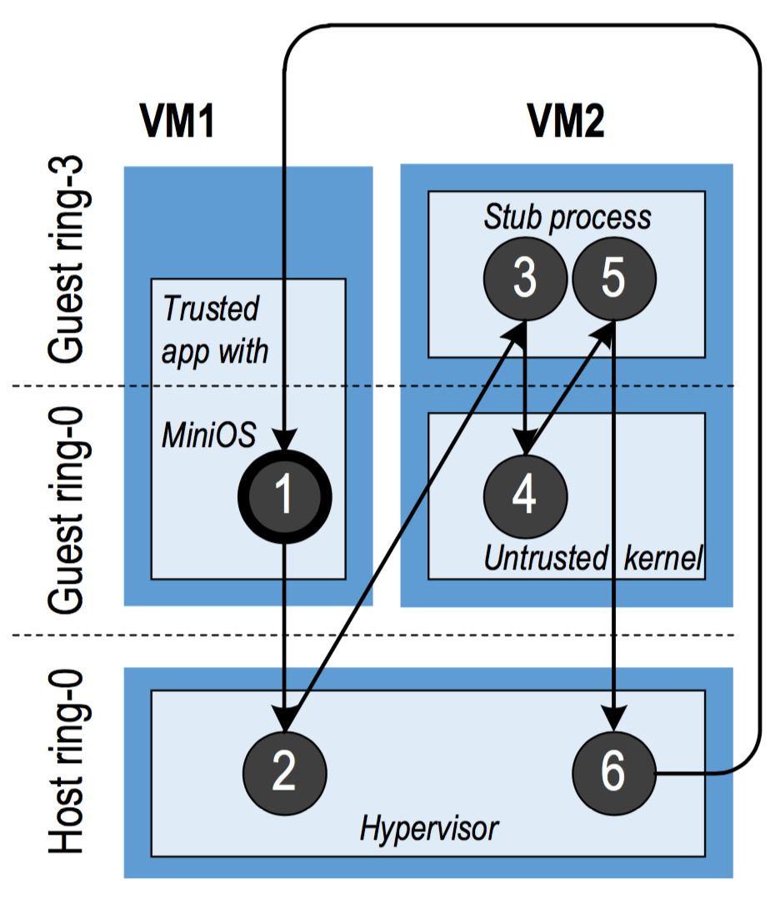
Cross-Mode Calls
ProxOS
Two virtual machines, one is trusted and the other is untrusted
Redirect untrusted system calls to the untrusted VMs
Overhead of mode switching could be high!
More
Nested Virtualization

Slide 43
Optimization for Cross-Mode Calls
Using shared memory (like FlexSC)
Make synchronous calls to asynchronous ones
Require app logic to be changed
How about a new instruction for world-call?
A world is just a mode (including VM, kernel/user, etc.)
Separating protection from managing
Configure by software (managing)
Check by hardware (protection)

